Slide 1
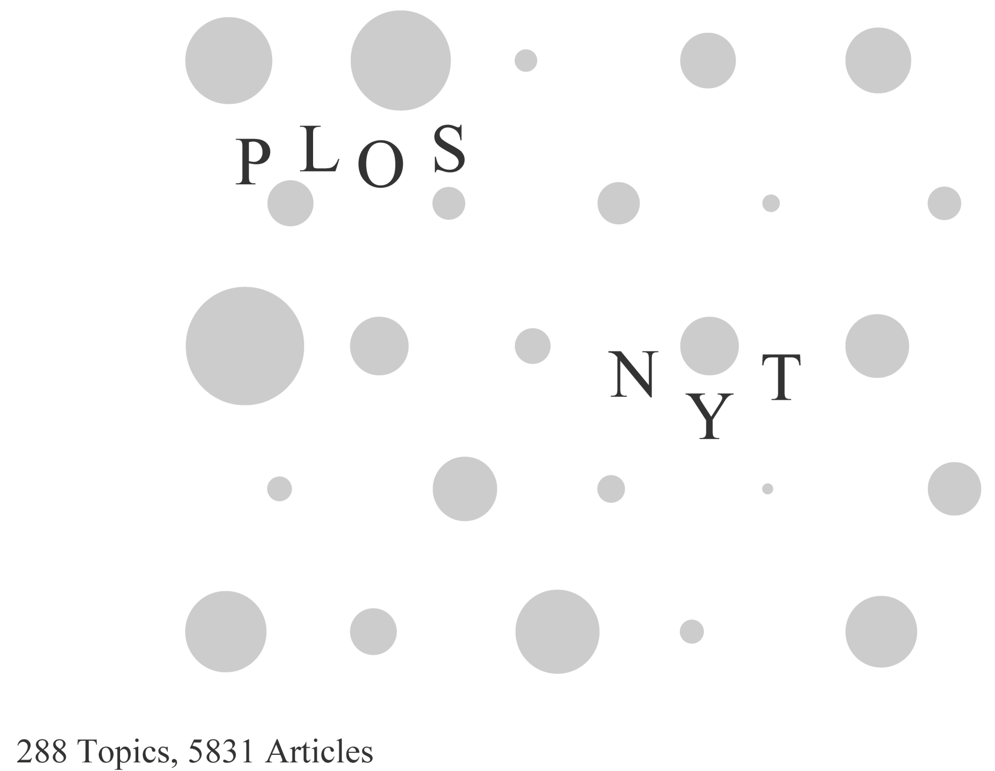
this is the
analysis

Slide 2
Discussion Outline
Distribution of Science Journal (PLOS ONE) and News (NYT) articles in a topic map
Article topics as a function of media source
Strength of the subject area (Math v. Ecology) as a predictor of article clustering

Slide 3
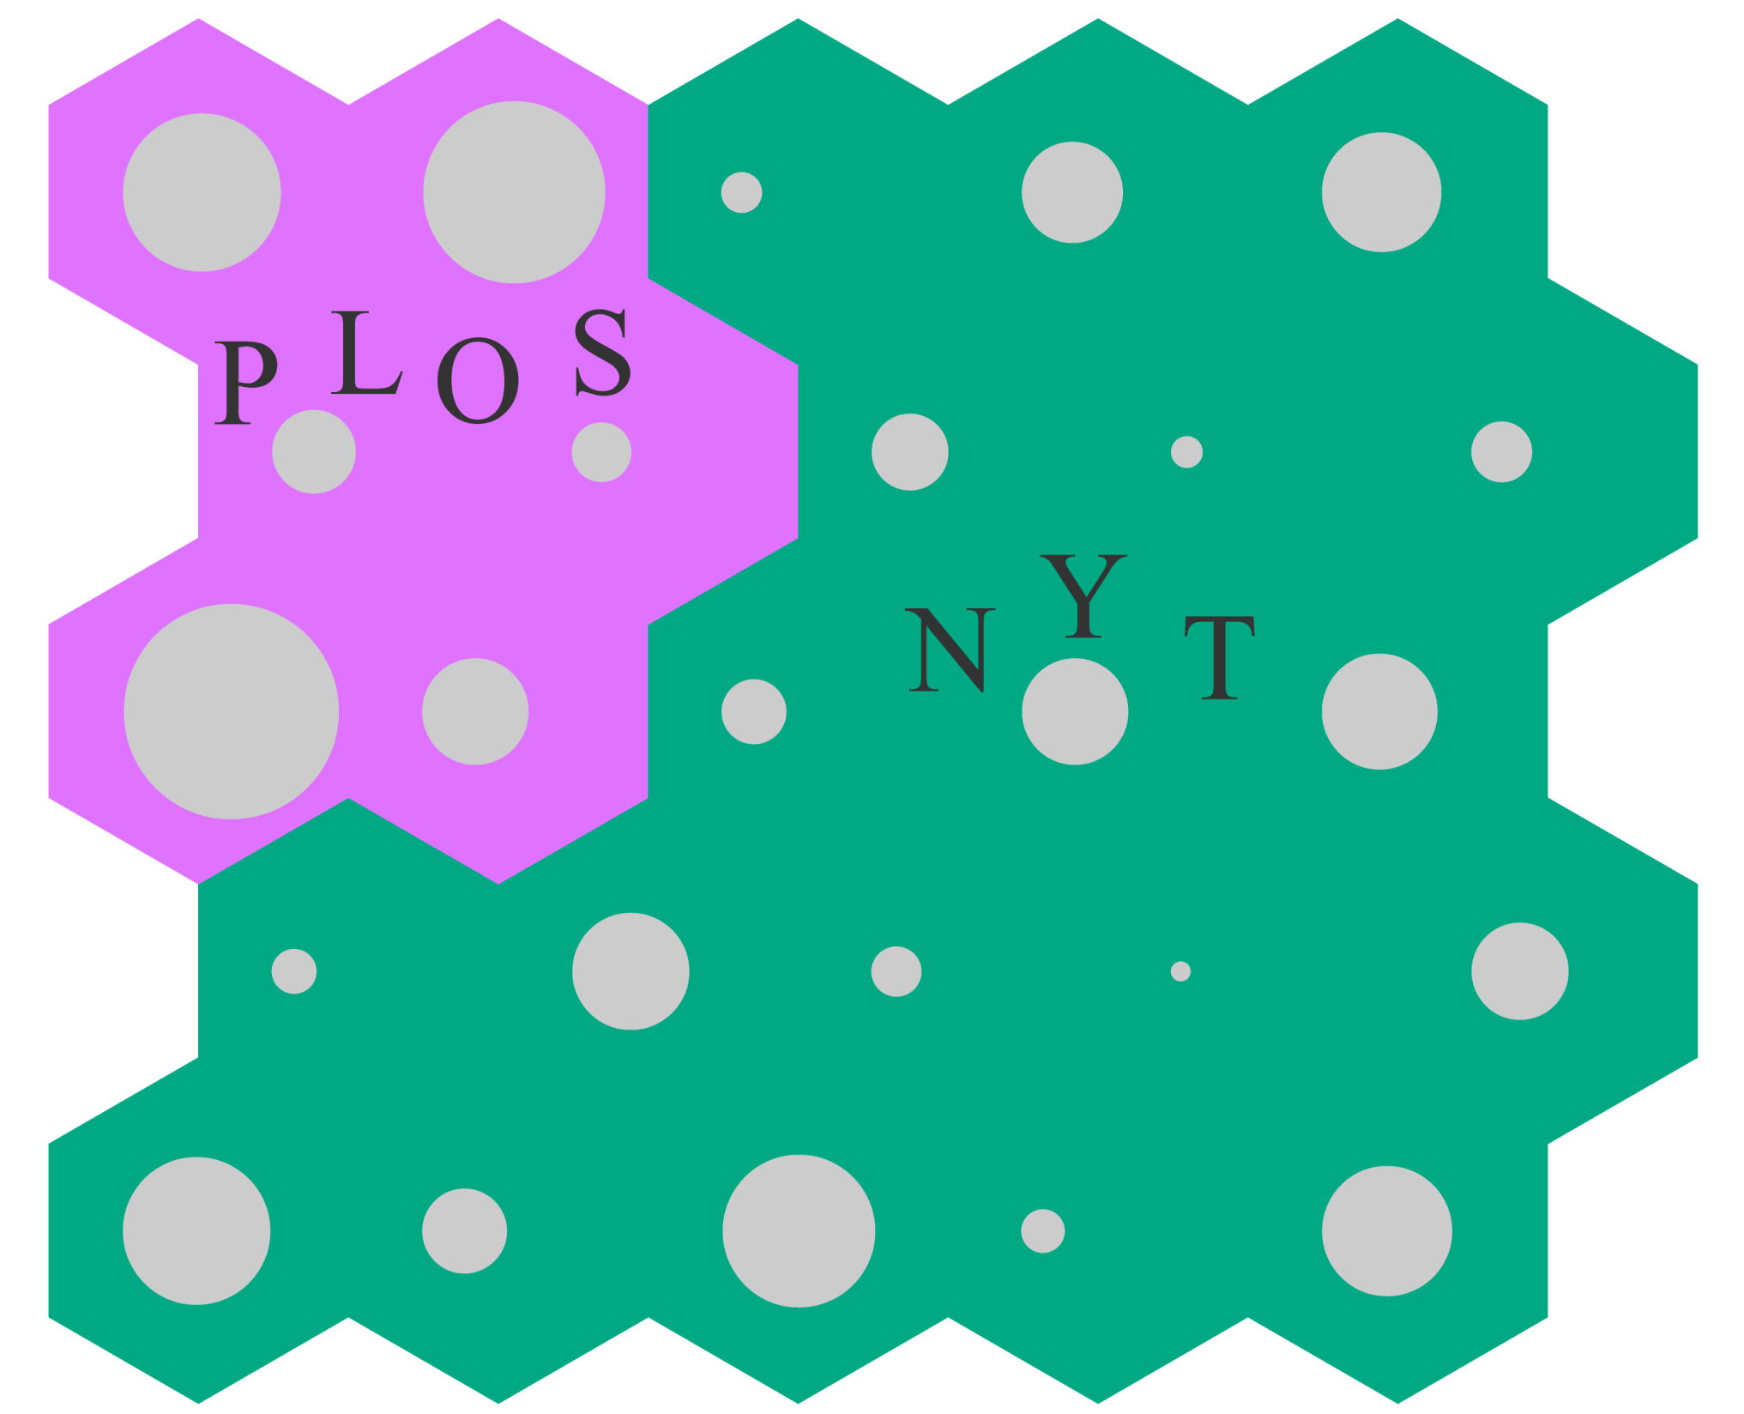
Notes:
Going to skip this slide but wanted to give you the image that there is the SOM/neural network behind the distribution of document clusters.
- Not the best way to understand the distribution though

Slide 4
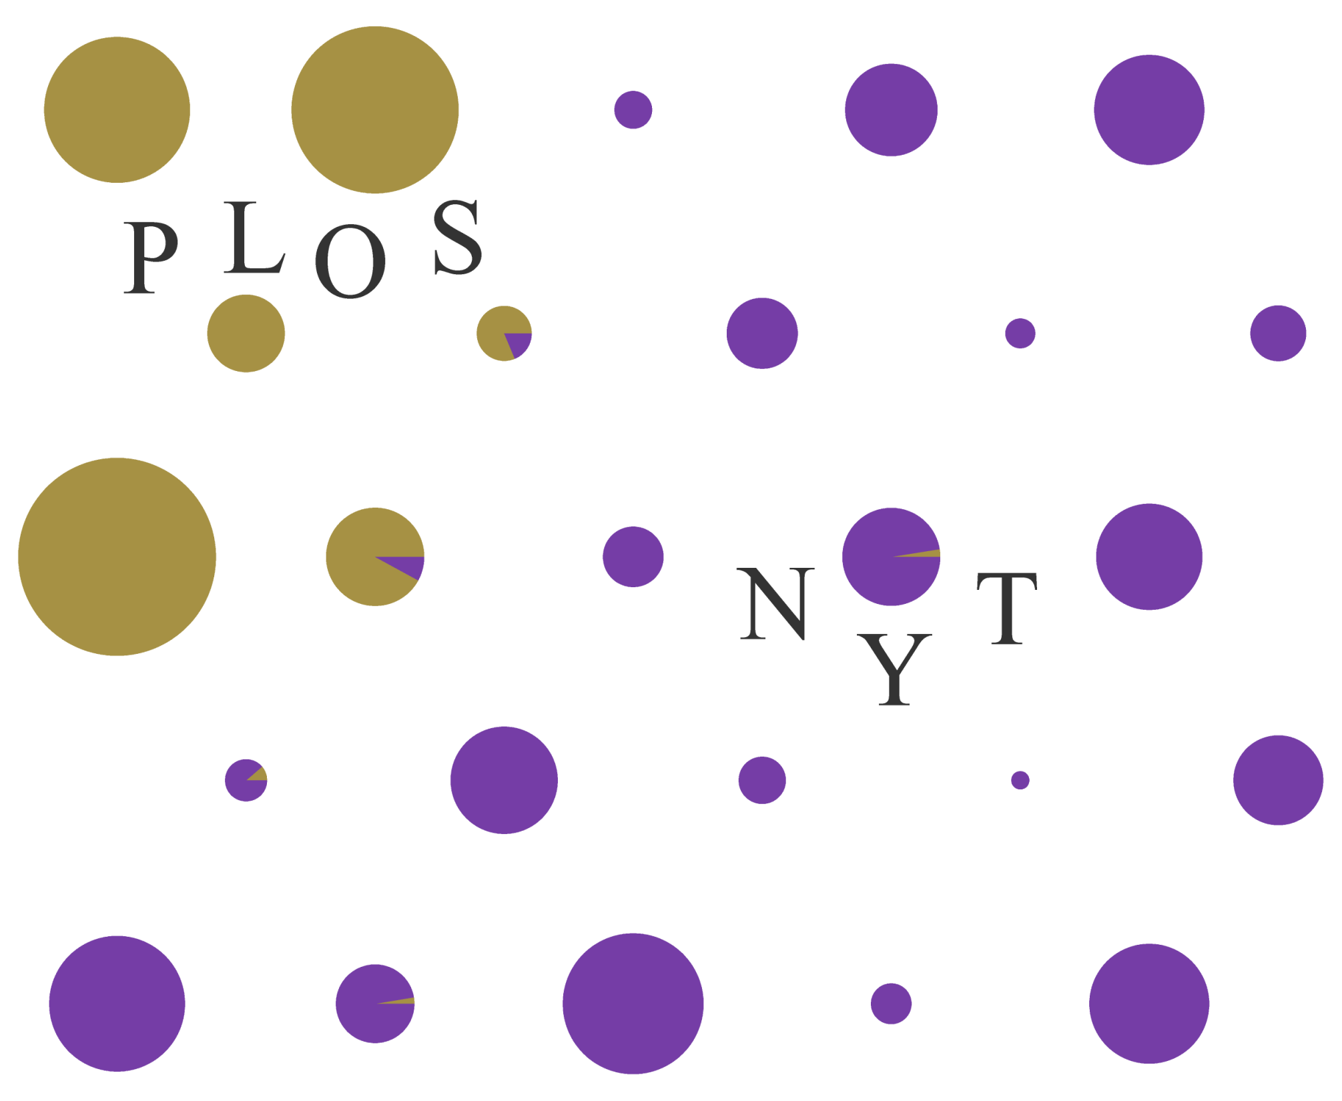
Notes:
Stark divide: i.e. very little/isolated overlap of PLoS and NYT articles in a topic cluster
With smaller number of topics
Don’t see how PLoS clusters together in a corner; looks like an even divide, so don’t see that they’re potentially more related
PLoS articles are more tightly related than NYT articles: in 288 topics, cluster in a corner, and interestingly towards top == more ecology?
Sidenote: may be nature of how the corpus was built rather than language differences

Slide 5
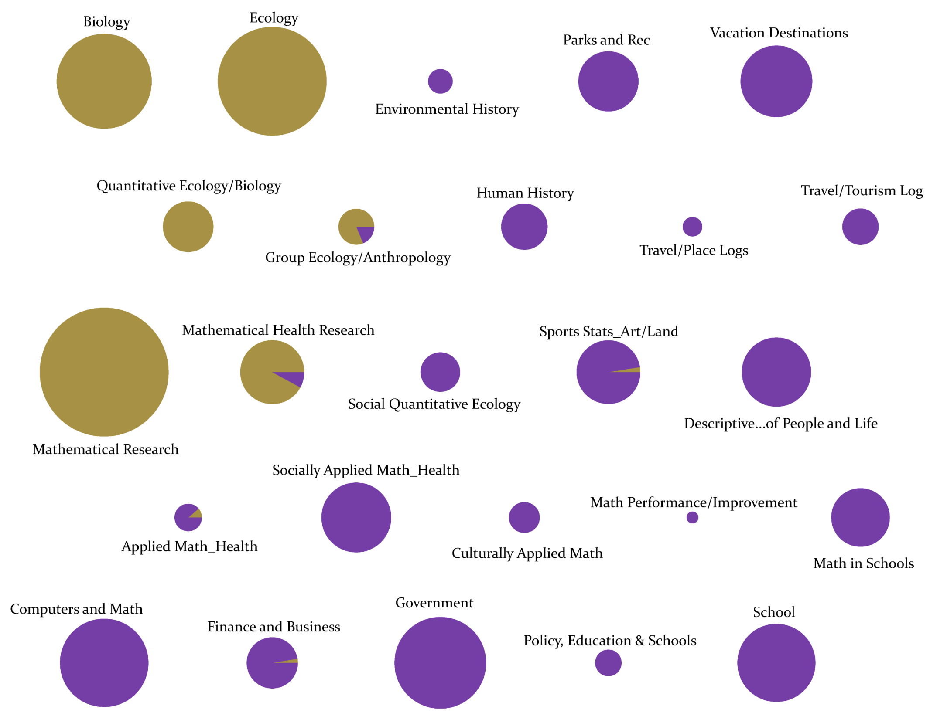
Notes:
DISCUSSION: What is PLOS about, and what is NYT about?
No distinct ‘biology’ ‘math’ or ‘ecology’ topics in NYT. Always circuitously related to science, not directly
IMO: talking about different things, most interesting:
math more related to school, and policy is about math in schools, as well as success/failure of math programs, investment in math education, parents and education
Ecology and biology are almost completely about travel (small national park subset)

Slide 6
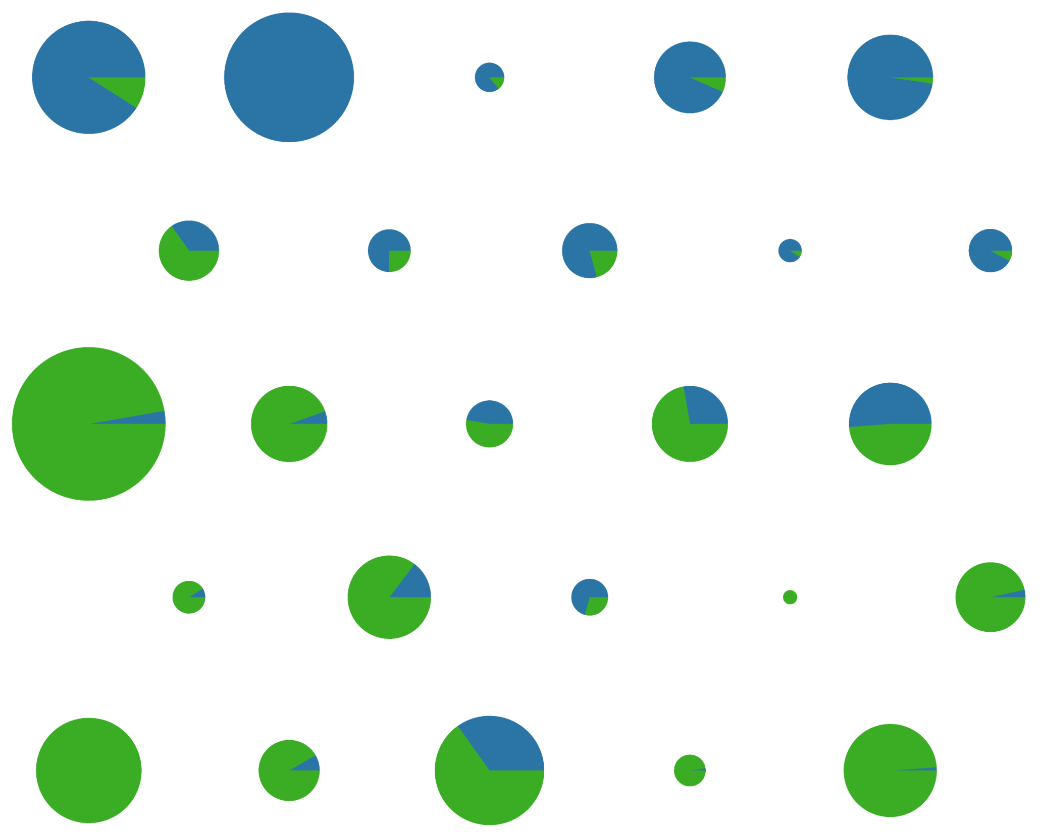
Notes:
Can you guess what this is?
Wanted to look at another aspect of how articles were distributed
Before looking at proportion of plos v. nyt articles
This is: proportion math versus ecology
Is there a meaningful divide/split of documents between the two topics?
Where draw the line?

Slide 7
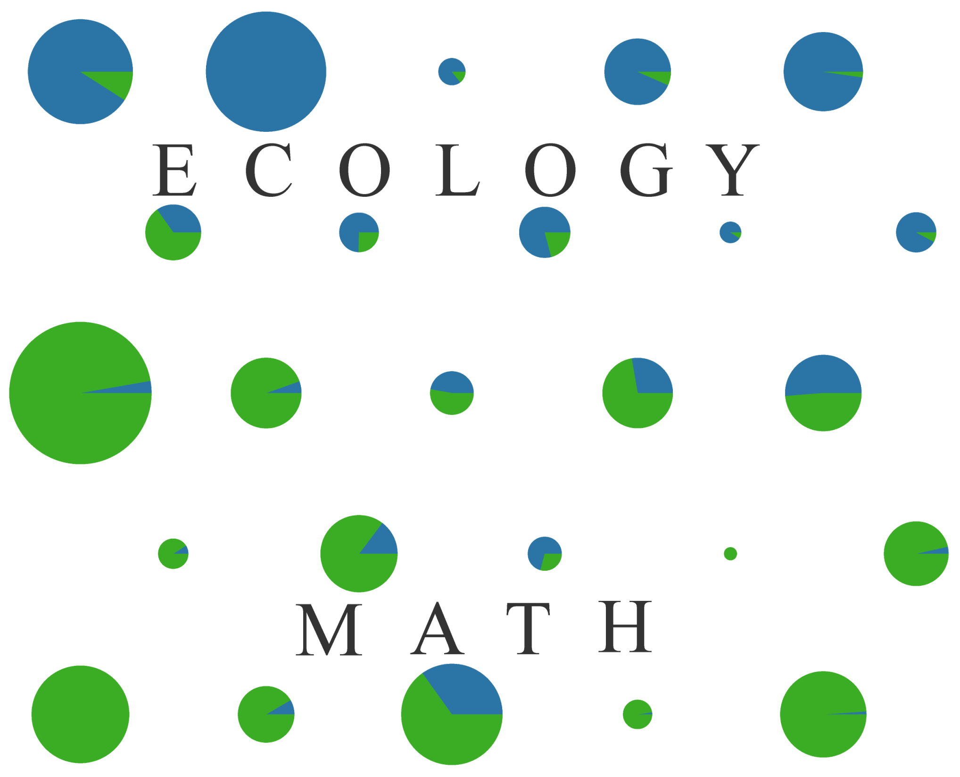
Notes:
Much less stark divide between ecology and math topics compared to PLoS and NYT: more overlap in topics

Slide 8
Notes:
If draw a line for Math versus Ecology the PLoS articles are up top. Does this mean they lean towards ecology?
- Appears that within the PLoS cluster still maintains the ecology vs. math split (evident with smaller number of topics)

Slide 9
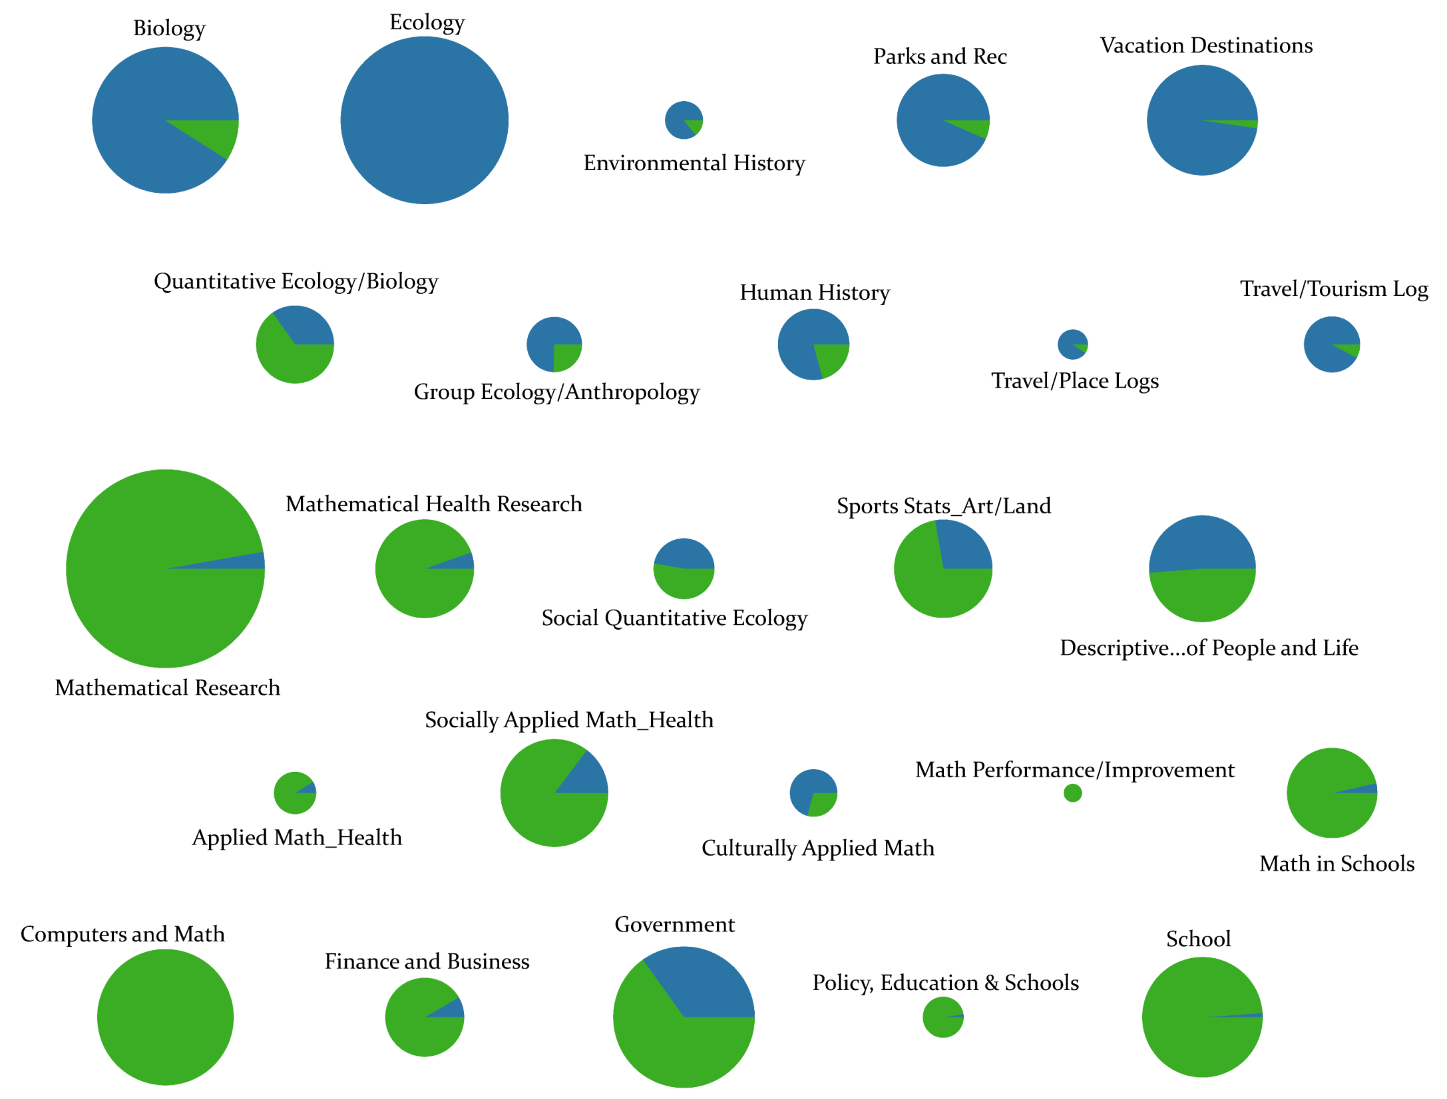
Notes:
DISCUSSION: given the quantitatively relevant spatial distribution of the SOM, what can we learn about the relationship of Math and Ecology topics?

